Slide 1












COMMITTEE TRAINING 25/26
FINANCES, BUDGETING AND SPONSORSHIPS

Slide 2


Finances, Budgeting and Sponsorships
CONTENT OVERVIEW
1. Understanding the role of treasurer
2. Understanding your student group fundraising account
3. Student Group Income and Expenditures
4. Team Leicester Finances
5. Raising money for charity

Slide 3
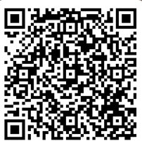
What do you think the Treasurer role entails?
Please write your answer in the form below by scanning the QR code.

Slide 4

01.
Role of Treasurer
  The Treasurer is the primary lead for the financial management of your Student Group, however it is the responsibility of all Committee Members to be aware of the Student Group's finances.
  The role will entail:
  Keeping an accurate record of all income and expenditures of the SG.
  Act as the primary signatory on the SG's funding account.
  Be responsible for coordinating grant funding applications and other financial dealings with ULSU and external bodies.
  Process deposits and withdrawals from the SG's funding account.
  Ensure prompt reimbursement of all approved expenditure.
  Ensure all funds (with the exception of external charity donations) are held and processed through the group's funding account at ULSU.
  Ensure all charity fundraising and donation is line with ULSU guidance.

Slide 5



02.
Student Group Funding Account
All affiliated Student Groups have a Funding/Fundraising Account. This is a bank account looked after by the Students' Union.
Please note: In line with UK Charity Law, Student Groups and LUSUMA Sub-Groups cannot hold money long-term in a bank account with any other provider, including personal accounts and any bank accounts opened under your Student Group's name.
Additionally, any money held in cash or in personal accounts is not covered by the Students' Union's insurance. This means we will not be able to refund if it is stolen, goes missing, etc. As a result, please ensure you transfer any funds to the Students' Union ASAP.

Slide 6
02.
Student Group Funding Account
The amount that a Student Group has in their funding account depends on what the previous committee has left over.
If a Student Group is a completely new Student Group, it will mean they will have £0 in their funding account.
If you are unsure of how much money is in your Student Group’s funding account, please email us at unionactivities@leicester.ac.uk to find out.

Slide 7
02.
Advice to manage Student Group Finances
We recommend at the start of the year, treasurers set out a budget for the academic year. This can be done by planning with your committee how many event you intend to run and then planning of ways to fundraise for each event.
Inform your committee members of your budget and your Student Group Funds to avoid any misunderstandings.
Set money aside in your budget for every event in case of an emergency e.g., an unexpected cost.
Make payments to those you owe money to as soon as possible rather.
Ask for help if you need it - don’t suffer in silence!

Slide 8
Transactions Reports and Monitoring Finances
Your committee will receive weekly transaction reports and balance updates to your Student Group's distribution email.
Please Note: If your Student Group has not had any income or expenditure during that week, you will not receive a Transaction Report.
We require all Student Groups to keep track of their own finances in conjunction with the Transaction Report so that you are always aware of how much money should be in your account. To do this, utilise our Budgeting Template.
Note: Your Student Group's Account must always remain in positive figures or your Student Group may become disaffiliated from the Students' Union. Any expenses that would put your group into negative figures will not be approved.

Slide 9

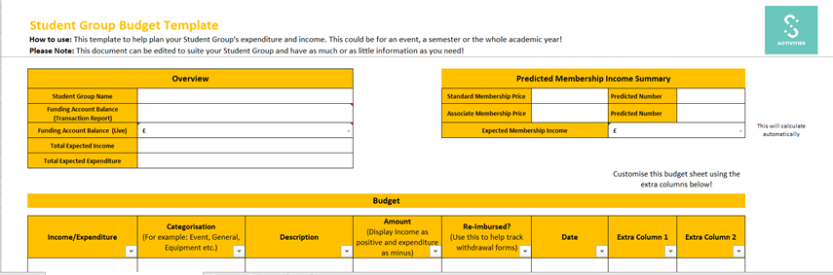
03.
The budgeting template looks like this:
The budgeting template will be posted on this page:https://www.leicesterunion.com/opportunities/societies/committeehub/studentgroupfinance/

Slide 10
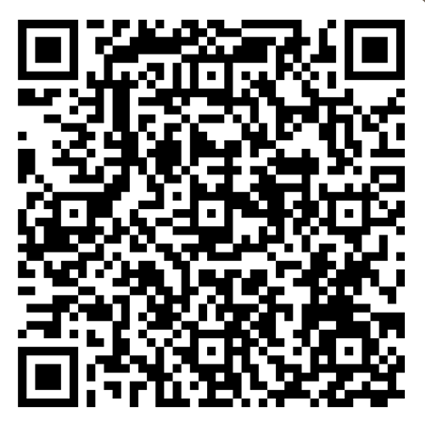
03.
Student Group Income
Before we move on to Student Group income, name one way you think
a student group can raise income.
Please write you answer in the form.

Slide 11
03.
Methods to raise Student Group Income
There are a few ways your Student Group can raise income:
  Membership fees - are fees paid by students to your student group to become a member of your student group. We recommend that Student Groups charge at least £3 for memberships. This helps your Student Group to run sustainably and to cover event expenses. If you are a Team Leicester club, this may be higher as we understand some sports can cost a lot more. You need to state your membership in your constitution and then we will set the membership up for you.
Please note: Memberships can only be bought through your Student Group's page on the SU website. Memberships taken directly via the Student Group will not be recognised by the Students' Union.
Membership Transparency - If you are charging for membership, it's crucial that your Student Group is transparent about what a member will gain as part of your society. This could be listed on your Student Group's webpage.

Slide 12
03.
Methods to raise Student Group Income
2.Selling Merchandise - When selling merchandise for your Student Group, consult with your members to see how much they are willing to pay and get quotes from different companies before making any commitments. You could decide to create a small profit on the sale of your products (maybe £1 or so per item) to reinvest into your Student Group. Merchandise should be sold directly on the Students’ Union website so that the money can go directly into your funding account.
To sell merchandise on the Students’ Union website:
  Login in to the Students’ Union website
  Click on Admin in the top right hand corner
  Click on your student group
  Click on products
  Click on add new product

Slide 13
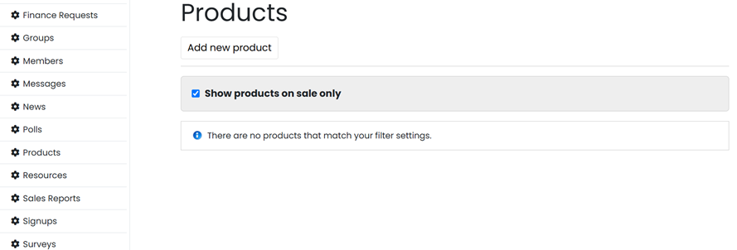
03.
Methods to raise Student Group Income
2.Selling Merchandise - This is what should appear when you want to sell merchadise:

Slide 14
03.
Methods to raise Student Group Income
3. Selling tickets to events - Selling tickets to events is one of the easiest ways to raise money for your Student Group and ensure that all running costs (such as venue hire and entertainment) are covered. All Student Group event tickets must be sold through the Students' Union website or sold at the door for last minute arrivals.
To sell tickets on the Students’ Union website:
  Login in to the Students’ Union website
  Click on Admin in the top right hand corner
  Click on your student group
  Click on event
  Click on add event
  Click on Admin again on the top right hand corner
  Click on tickets
  Click on add ticket for the event you just entered

Slide 15
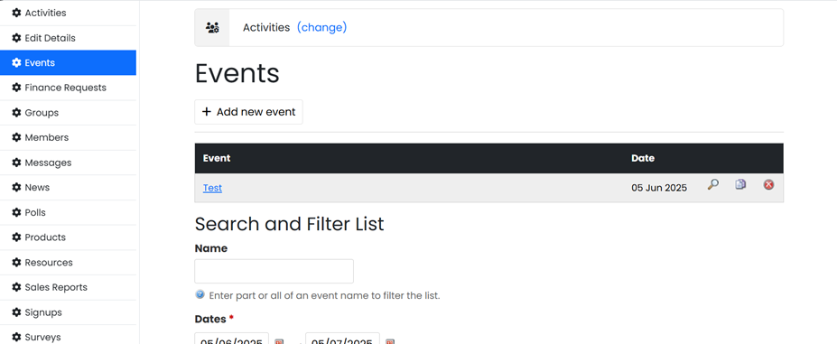
03.
Methods to raise Student Group Income
2.Selling tickets - This is what should appear when you want to sell tickets (first setting up the event):

Slide 16
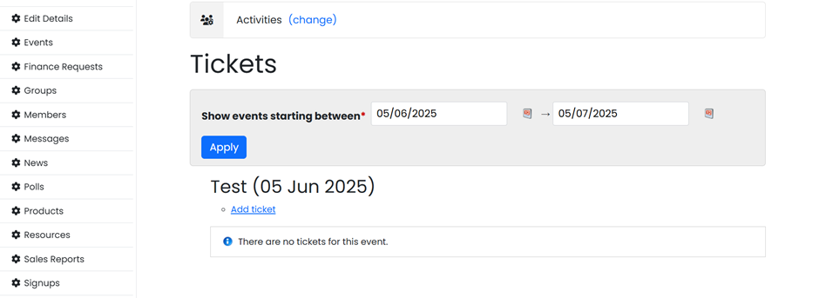
03.
Methods to raise Student Group Income
2.Selling tickets - This is what should appear when you want to sell tickets (then setting up the ticket):

Slide 17
03.
Methods to raise Student Group Income
4. Grant Funding - Every year, the Activities & Volunteering Department has funds available to support affiliated Student Groups in their development, and achieving their constitutional aims and objectives. Grant funding does not need to be paid back.
Examples of what your Student Group could use Grant Funding for include: trips, campaigns, transport, equipment and much more. Please see the Grant Funding guidelines for more information.
Please note that submitting an application for Grant Funding does not automatically mean that you will be awarded grant funding. We recommend you consider how you will fund your activity/equipment/event if you do not receive Grant Funding. If you were previously awarded granted funding, it does not guarantee you will receive it again.
Grant funding application form and guidelines https://www.leicesterunion.com/opportunities/societies/committeehub/studentgroupfinance/

Slide 18
03.
Methods to raise Student Group Income
5. Sponsorship - Sponsorships are a fantastic way to build a relationship with a company whilst sometimes also getting a financial bonus. A sponsorship is an agreement where usually if you promote a company, you will some benefit in exchange.There are 4 key steps in trying to secure a sponsorship:
1. Research: Look at business who your Student Group already have an existing relationship with or ones that align with your Student Group interests/values
2. Proposal: Get in contact with them and propose what you are looking for.
3. If you reach an agreement, please use our template sponsorship contract to fill out the details of sponsorship which you can find on the Student Group finances webpage.
4. Before signing to a deal, please contact unionactivites@leicester.ac.uk and we can provide you with the next steps to creating a signed agreement. This is to ensure that your Student Group is being subjected fair terms and conditions.

Slide 19
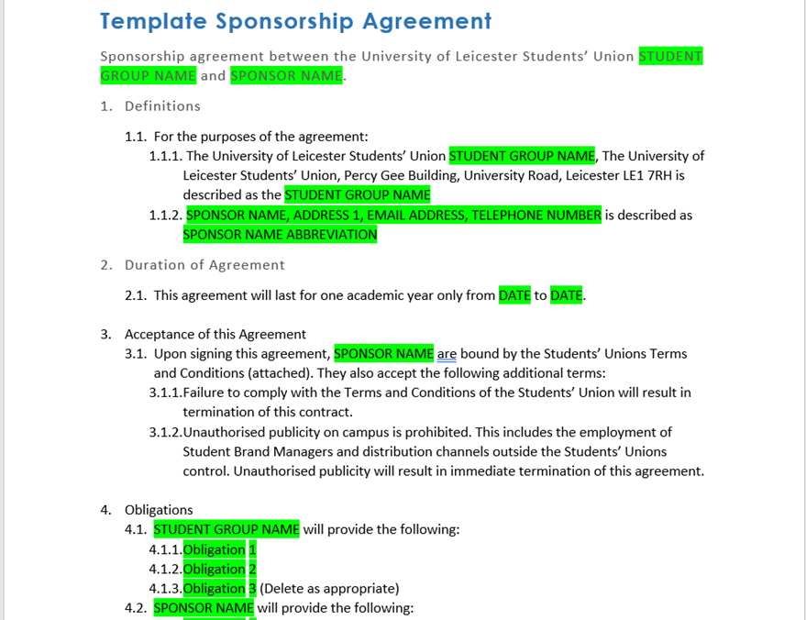
03.
This is what the template sponsorship contract looks like:
Sponsorship contract: https://www.leicesterunion.com/opportunities/societies/committeehub/studentgroupfinance/

Slide 20
03.
Methods to raise Student Group Income
6. Provide a service - You student group can provide a service, this particularly applies if you are a performance or musical group. You can use our invoice template to invoice the whoever needs to pay for the service. Student groups can also use our invoice template to invoice a third party, such as a sponsor, for money owed to your group .
To fill in the Invoice Template, please:
  Write in the details of company or individual you are invoicing
  Fill in your Student Group Name (do not use abbreviations/acronyms) along with the invoice date and the date due (usually within 30 days of sending the invoice)
  Fill in the details of what needs invoicing for example ‘Sponsorship for the 2023/24 Academic Year’ or ‘Concert Payment’, and fill in the price and amount.
  Send to the company or individual you are invoicing.
Please Note: When sending an invoice, you should also email su-finance@le.ac.uk with the amount expected and who from to ensure that we can match the funds with your group. If the third party does not reference your group, the funds will be delayed in being allocated to your group’s funding account.

Slide 21
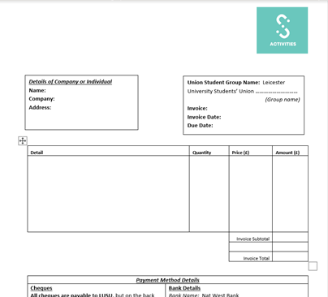
03.
This is what the invoice template looks like:
Invoice template can be found here: https://www.leicesterunion.com/opportunities/societies/committeehub/studentgroupfinance/

Slide 22
03.
Student Group Income - further information
All income generated through Student Group memberships and online event tickets purchased through the Students’ Union website will be directly transferred into your Student Group’s funding account under the code ‘MSL’.
As a Students’ Union, we have a ‘SUMUP’ Card Reader that can be loaned to Student Groups. This can be booked through the Event notification form. We can only book the card reader out to one Student Group a day so submit your form as soon as possible. When using the card reader, please return it as soon as possible so it becomes available for other student groups.
Event notification form: https://www.leicesterunion.com/surveys/roombookings/

Slide 23
03.
Student Group Expenditure
Student Group expenditures are made when a Student Group needs to make any payments.
You can only use your Student Group’s funding to pay for the benefit and development of your Student Group.
You cannot use your Student Group’s funding to pay for the personal use of Committee Members or any individual members.

Slide 24
03.
Student Group Expenditure
Your Student Group can make payments in 2 ways:
1.A committee member can purchase the item with their own money and be paid back using your Student Group’s money. We recommend this method when the item requires immediate payment such as buying food at a supermarket for an event.
2. Pay the supplier/company using your Student Group’s money. You can ask the supplier to send you an invoice and attach this on to your reimbursement request (this will explained in more detail later). We recommend this method when the item does not require immediate payment such as paying a deposit for a venue.

Slide 25
03.
Creating a reimbursement request
To make a payment, your Student Group will need to submit a reimbursement request on the Students’ Union finance portal.
To access the finance portal, you will need to:
1. Log into the Students’ Union website
2. Click on admin tools in the right hand corner
3. Select your Student Group
4. Select the finances tab

Slide 26
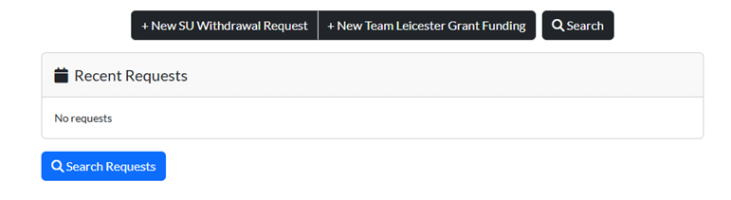
03.
Creating a reimbursement request
The finance portal looks like this:
Select 'New Team Leicester Grant Funding Request' or 'New SU Withdrawal Request' button
Please Note: Only select Team Leicester Grant Funding if you have been pre-approved by Team Leicester for this specific expense. If you have received Grant Funding from the Students' Union, please use the 'New SU Withdrawal Request' and state that the money is coming from grant funding in the request.

Slide 27
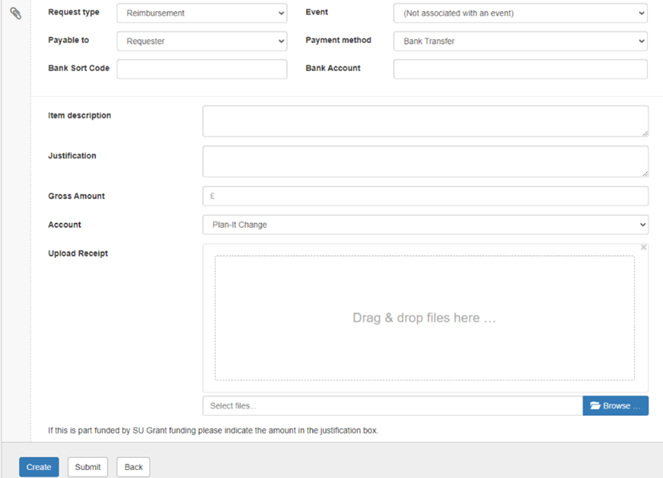
03.
Creating a reimbursement request
Then complete the form by filling out the following details, this can only be done by a committee other than president (as if the president submits, the president will not be allowed to approve the request later on :
Once you have added all details you have 3 options:
1. 'Create' then 'Save Changes' - the request will not be submitted and you will be able to edit and submit later
2. 'Submit' - the request will be submitted for the next stage approval.
3. ‘Back' - the request will be deleted and you will be redirected to the dashboard.

Slide 28
03.
Creating a reimbursement request
Once the request has been created by the treasurer or a committee member other than president, you will need to approve it. To approve a request, simply select the request you would like to approve.
With each request you will have 3 options:
Approve- Choose this if you are happy with the request, there are enough details and receipts are attached and match the request details.
Refer to requestor - Choose this if you have queries about the request, some details are missing, evidence is missing or details do not match.
Reject - Choose this if the request does not have sufficient details, the purchase is personal, your group does not recognise the expenditure or your group does not have enough funds.

Slide 29
03.
Creating a reimbursement request
Once you are on the Students’ Union finance portal, you can create a reimbursement request. The process to create a reimbursement request are as follows:
  Select whether you're making a SU Withdrawal request or a Team Leicester Grant Funding Request
2. 'Request is created' - Created by the anyone other than president
3. 'Request is approved by Treasurer' - Approved by the treasurer
4. 'Request is approved by President' Approved by the president
5. 'Request is approved by Activities Staff' - Approved by the Activities team if the request has no issues. We may refer the request if we require more information, we may reject the request if the purchase is personal or you do not have enough funds to pay for the purchase.
6. Request is processed by Finance Team' - Paid by finance

Slide 30
03.
Student group expenditure
Add Fuel Reimbursement: To reimburse fuel, you should use AA Route Map to show the route the payee has taken. We reimburse fuel at a maximum rate £0.45 per mile. We don’t reimburse car travel according to petrol station receipts. You can reimburse at less that £0.45 if the payee has agreed to this. A copy of the route and the calculation should then be attached as evidence in your reimbursement request.
AA route map: https://www.theaa.com/driving/mileage-calculator.jsp
Attaching proof: Please ensure you include the full proof of purchases in your reimbursement request, if you do not do this your reimbursement request will not be approved.

Slide 31
04.
Team Leicester Student Group Finances
If you are not a Team Leicester Student Group, you can disregard this slide.
All Team Leicester clubs are given their Team Leicester grant funding budget at the start of the academic year. Team Leicester Clubs also have a funding account like other student groups. This grant funding budget is allocated to specific categories: coaching, referee fees, affiliations, entry fees, facility hire and travel. Some clubs may have additional categories.
Money can only be spent on the categories they have been assigned to. For example, you can only spend your coaching allocation on coaching- you cannot put this money towards entry fees. This is because Sport and Active Life receive their funds in these categories.
At the end of the year any leftover money in your grant will be absorbed by the University as a whole - not specifically the sports department. This grant can only be spent on BUCS competitions (or your club's main competitions if you do not compete in BUCS).Any money spent on friendlies will need to be covered by your club's fundraising account.

Slide 32
04.
Team Leicester Grant Funding
At the start of the year, treasurers should budget to work out much they can afford to spend over the year (how many coaching hours, hours of facility hire etc.). Throughout the year, Treasurers should be continually monitoring the budget to ensure that there is not an overspend in any controllable category.
What budgets do clubs receive from TL Grant Funding?
Non-Controllable Budgets - These budgets are set by TL to cover some of the clubs' specific costs. A non-controllable category is classed as any category cost outside of a club's control- i.e. how much you spend on transport (as this is booked for you), match officials (as these are a set fee for BUCS fixtures) or affiliations (as this is a set fee by your sport's National Governing Body). If you have an overspend on match officials, affiliations or transport, Team Leicester will cover this.
Controllable Budgets - These budgets are given by TL for club’s to control. Controllable categories are coaching (as it is the club's responsibility to work with their coach and decide how many hours they can afford), entry fees (you decide how many athletes you can afford to enter into an event) and additional facility hire (if you want extra facility hire on top of what you have already been allocated). They are based on the Tier System therefore there are three different amounts for each, depending on which tier a club is in. Please make sure that you have checked with TL as to whether the budget can be used before any items are purchased. You can check by emailing teamleicester@leicester.ac.uk
If there is an overspend in a controllable category, the club will have to fund this from their fundraising account. Coaching, entry fees and additional facility hire are the club's responsibility to manage.

Slide 33
04.
Team Leicester Grant Funding
With your TL grant, you won't ever actually see this money. Instead, you will reimburse yourselves from it or submit invoices (from coaches, facilities etc) to the SU finance portal for payment and are reviewed by Team Leicester.
For coaches, they need to submit both a personal invoice and a Team Leicester invoice each month. These should then be uploaded by the committee to the portal.
For match official reimbursements, captains should pay the officials themselves. They then need to get the official to sign a 'match official receipt' form and then upload this to the portal for reimbursement.
Clubs should upload any reimbursement requests to the portal as quickly as possible so that people can be reimbursed promptly for any monies they have spent.

Slide 34
04.
Team Leicester Club Contributions
Sometimes, clubs decide that they need more money than their TL grant gives them in controllable areas such as coaching or external facility hire.
Clubs usually realise this once they sit down at the start of the year to decide how many coaching hours/ facility hire hours they can afford. Clubs can make a contribution to any area
If clubs want to make a contribution, they need to contact teamleicester@le.ac.uk and let them know how much they would like to contribute. This may be £200 towards coaching. Clubs can add to their contribution at any time and should monitor their budgets closely to see whether a contribution is needed.
This additional £200 will then be added to their grant. At the end of the year, any unspent contribution will be automatically returned to the club's fundraising account.

Slide 35
05.
Raising money for charity
The Students' Union is a registered charity, and so, all affiliated Student Groups are part of the registered charity. Therefore all money that is fundraised for charity must be banked through the Students' Union to comply with UK Charity Law. This applies for all Student Groups all year round, including out-of-term time.
Once you have completed your fundraiser, you must download the Charity Donation Form from the Student Group Finances webpage to ensure you have followed UK Charity Law.
If you are raising money via an established online platform (e.g. JustGiving) then you must let us know by emailing unionactivities@le.ac.uk. Once your fundraiser is finished, you must let us know the total that has been donated online, so that we can update our records.
As well as ensuring that we abide by UK Charity Law, this process also makes sure that your Student Group gets recognition for all of your fundraising!

Slide 36
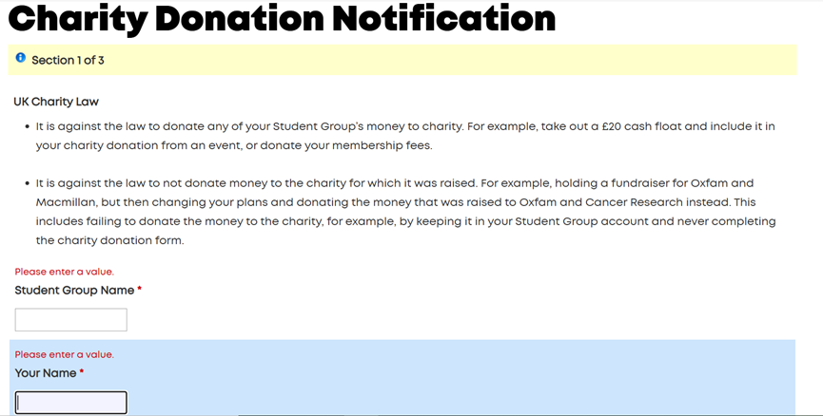
05.
The charity donation form looks like this:
Charity donation form: https://www.leicesterunion.com/opportunities/societies/committeehub/studentgroupfinance/

Slide 37
05.
Before organising a fundraiser
Before you decide to organise a fundraiser and donate to charity, please ensure that you select a charity:
·That is a UK registered charity with a seven-digit charity number (which you can find here: https://www.gov.uk/find-charity-information).
·That accepts donations.
·That covers the cause that you are passionate about.
Please select your charity carefully as you cannot change your chosen charity once you have decided to hold a fundraiser for this charity. It is against the law to not donate money to the charity for which it was raised. If you have any queries about charities or are unsure of selecting a charity, please email unionactivities@leicester.ac.uk.

Slide 38
05.
Before organising a fundraiser
Once you have selected your chosen charity, please complete a room booking/event notification form of your fundraiser at least 2 weeks prior to your event.
Decide how you will fundraise – will you just ask for donations? Or will you be holding an event and then donate the revenue from the event to charity? Please note all of your donations must be donated to charity, you cannot donate only some of these donations.
Decide how you will receive the donations - will you require a card reader from the Students’ Union? Will you use a QR code to receive the donations?
To book card reader, please visit: https://www.leicesterunion.com/surveys/roombookings/

Slide 39
05.
During and after organising a fundraiser
During your fundraiser:
During your fundraiser, we recommend that you keep a written record of the donations you have received to ensure that you are donating the correct amount that was raised for the charity.
After your fundraiser:
Confirm the amount of donations your student group raised, by checking your written record of donations and by emailing unionactivities@leicester.ac.uk to check the donations you received using the card reader. It is against the law to donate any of your Student Group’s money that are not the donations, such money from memberships, to charity.
You must donate the money as soon as possible and complete the charity donation form as it is against the law to keep the donations in your Student Group account.

Slide 40
05.
Charity donation law summary
It is against the law to donate any of your Student Group’s money that are not the donations, such money from memberships, to charity.
It is against the law to keep the donations, whether that is the full or partial amount, in your Student Group account.
It is against the law to not donate money to the charity for which it was raised.

Slide 41
Resources to use as Treasurer
Please visit our Student Group Finance webpage (https://www.leicesterunion.com/opportunities/societies/committeehub/studentgroupfinance/) to find the budgeting template, our sponsorship agreement template, our charity donation form, grant funding guidelines and more information that is relevant for treasurers.
Use the AA route tracker (https://www.theaa.com/driving/mileage-calculator.jsp) to calculate fuel reimbursements.

Slide 42
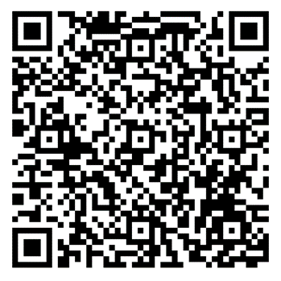
Name one thing you have learnt in today’s session.
Please write your answer in the form.

Slide 43
Questions?
If you have any questions or concerns about your role or your Student Group after this session, please email unionactivities@leicester.ac.uk.

Slide 44
Thank you!

