Slide 1
Officer Elections 2021
Campaigning Workshop

Slide 2
Aim of this session
Prepare candidates to make effective use of the Election campaigning window.
Of course, we cannot guarantee you will win by coming to this session, but we will outline some practical tips to help you along the way.

Slide 3
Objectives
Describe the features of effective election campaign
Identify the principles of persuasive communication
Outline how social media can be used to reach a wider audience
Evaluate examples multimedia campaign materials
Explain the value of positive campaigning in elections with multiple candidates

Slide 4

Running an effective election campaign

Slide 5

What does an effective campaign look like?
Targeted
Visible and creative
Passionate
Persuasive
Clear vision or message

Slide 6

Targeted: Who am I speaking to?

Slide 7
Who am I speaking to?
Students may sit anywhere on the spectrum to the right.
It is important to think about who you are speaking to and how you may engage them.
Part of the movement
Active allies
Passive supporters
Neutrals
Passive opponents
Active opponents
Opposition

Slide 8
Who am I speaking to?
Students at the top of the spectrum are already likely to vote for you.
These are the people that will support you in your campaign, and can be recruited to help you spread the word.
You don’t need a big team, but it helps to have supportive people around you.
Part of the movement
Active allies
Passive supporters
Neutrals
Passive opponents
Active opponents
Opposition

Slide 9
Who am I speaking to?
Students at the bottom are unlikely to vote for you, no matter how hard you work to change their mind.
In the 2-party national political landscape, a lot of energy is spent trying to discredit the opposition.
This is far less effective in SU elections as there are multiple candidates and we use transferable voting.
Part of the movement
Active allies
Passive supporters
Neutrals
Passive opponents
Active opponents
Opposition

Slide 10
Negative campaigning
In a first-past-the-post election, negative campaigning has proven very effective as voters ultimately choose between 2 viable options.
Candidates are not worried about the effects their negativity may have on their own image, as long as they damage their opponent’s reputation more than their own.
Many people do not vote in general elections, citing that they do not like either candidate.
In SU elections, with multiple candidates and transferable voting, voters always have another option.
A negative campaign may damage the image of your opponent and yourself, leaving the door open for a third candidate or the Re-Open Nominations (RON) option.

Slide 11
Who am I speaking to?
A targeted campaign prioritises time, energy and resources towards students in the middle, or swing voters.
These may be students who have not yet decided who to vote for, or who may not have considered voting.
Part of the movement
Active allies
Passive supporters
Neutrals
Passive opponents
Active opponents
Opposition

Slide 12

Visible: Social media

Slide 13
Platforms
Instagram, Twitter, Facebook, Tiktok
Think about: cross-posting content, i.e. making a Tiktok then using it on Insta Reels. Making one high quality item is great, but how many different places can you post it to drive more engagement towards your campaign?

Slide 14
Faces and media content
Faces perform better than posts without them:
https://www.diyphotography.net/photos-faces-perform-almost-40-better-instagram-study-shows/
Image of man on Skyscraper: https://en.wikipedia.org/wiki/Skyscraper_design_and_construction#/media/File:Old_timer_structural_worker2.jpg

Slide 15
Social Media: The Basics
Communicating with your audience – Promote your campaign with engaging tweets, photos, videos, polls, Q&A's. You are the face of your campaign.
Responding to your audience - Engage and interact with comments/responses/questions wherever possible to show you're there and responsive to the students you want to represent.
Keeping your ear to the ground – Respond to topical issues as well as talking points you have seen other candidates engaging in if you feel they are relevant to your campaign. It is worth following the other candidates.
Notes:
Processes as a team:
Submitting a marketing request form – This allows us as the Marketing Team to track and monitor projects/campaigns. The request is to be submitted when the campaign idea has been refined and is submitted once 1:1s with me have taken place and a consultation with the rest of the team (if necessary – more for large scale campaigns). We ask for as much detail to be included in this request, as often it will be Aisha or Kerrie looking at the request so all the important information needs to be to hand. To access and complete the marketing request form: https://www.leicesterunion.com/surveys/250/. The form also asks you which SU staff members will be needed to support the campaign and whether Union Ambassadors can help support the project.

Slide 16
Social Media 2
Commenting on issues the right way – The University, Students’ Union, previous Officers or your opponents may say or do things you disagree with. It's how you respond to this that will draw engagement.
Too Passive: Seems like you're unfussed, not passionate, don't care.
Too Aggressive: May not get a response as your reply to them did not allow them the opportunity to correct/open up a conversation around the topic in which they have put out questionable messaging
It's about STRIKING A BALANCE.
Remember, it is possible to create dialogue around the issues without hurting your image.
Notes:
I am Charlotte, the Campaigns Development Coordinator. I bridge the gap between Exec Officers and the Marketing Team, to ensure that campaigns/projects are delivered smoothly and on time. My role was created because Officers felt that they needed more support with their campaigns – sharing ideas, planning and executing the project itself. The role of Officer is very busy, so I am there to support you as much as possible with your campaigns. This is what I can support you with:
Running through ideas and establishing the WHY – sometimes it helps to talk through your initial ideas and expand on these, mind mapping the vision for the campaign, understanding why you want to run a campaign.
Planning your campaign – setting objectives, creating timelines, refining messaging, exploring ways of marketing the campaign effectively, bringing in appropriate staff members e.g. Bethan, if the campaign has a wellbeing/MH focus (support around safeguarding, student welfare, student mental health, tone of messaging). Assigning roles in the project team (project sponsor, project manager, project support).
Practical support – event support, setting up webpages, organising resources, union ambassadors, admin tasks, help with budgeting
Project management skills – especially during busy periods you may feel a bit overwhelmed so I can help with shifting priorities and ensuring that campaigns are not causing you to burn out.
Campaign reflection – thinking about what went well and what could be improved for last time. Important for self-development but also ensuring that future campaigns are as impactful as possible.
We will have fortnightly 1:1s where we will have the opportunity to refine your ideas and discuss how myself, the marketing team and SU staff can support you in making your campaigns a success.

Slide 17
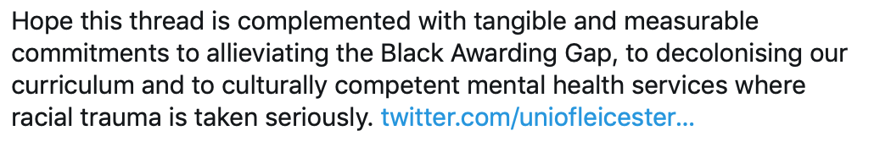
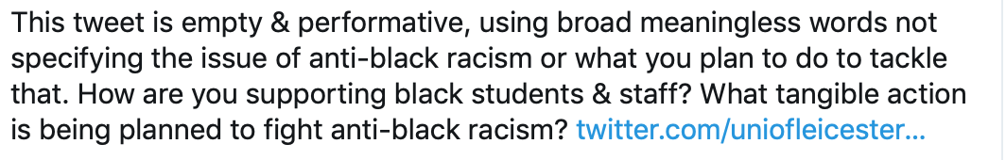
Examples of striking the balance:

Slide 18

Creative campaigning

Slide 19
Creative campaigning
Innovative campaign content that students find amusing, surprising or entertaining might be more likely to be shared than purely factual information
In 2015, President Candidate Rachel Holland created an Uptown Funk parody music video to spread the word about her ideas.
The video was played over 20,000 times, and the song was even played on BBC Radio 1.
Of course, a viral video doesn't guarantee the win, but more students seeing the content means more students hearing your campaign message.
Think about what you could do to capture a larger share of students’ attention.

Slide 20

Passionate and persuasive

Slide 21
Persuading potential voters
Turn students into supporters
Turn supporters into voters

Slide 22
Turning students into supporters
Conveying the importance of the issues
Context – understanding the WHAT – analyze the problem & the context around it that the campaign will address. Social issues commentary on social media platforms works well.
Passion – students more likely to invest in a campaign that a person is passionate about, or cares about, don't half-heartedly oversell in lots of areas, focus on one or two key ones.
People centered – Tell a story, focus it on case studies if possible, tell your own story: voters want to know you're a human being too.
Clear, succinct messaging – No point running a campaign if students don’t understand what you’re wanting to change.
Call to action!

Slide 23
Turning supporters into voters
Why should I vote?

Slide 24
Turning supporters into voters
You will come across students who are not interested in the elections.
The best thing you can do is remain positive, explain the reasons for voting we have just discussed, and be sure to make a good impression.
While someone may say they are not interested at the start of the campaign period, they may later decide to vote, so you want to make sure they have had a positive experience with you.
Remember though, you cannot pressure students into voting or vote on their behalf.

Slide 25

A clear message: Sharing your vision

Slide 26
Manifesto
Manifestos will be available on the SU Elections website.
Your manifesto tells voters who you are, what you stand for and what you would like to achieve if you are elected.
Specifications
Full-Time Officer manifestos can be up to 3 A4 pages (portrait).
Part-Time Officer and NUS National Conference Delegate manifestos should be 1 A4 page (portrait).
You may include images.
Focus should be on the key points/messages of your campaign.
Please submit in PDF format.
Manifestos must be emailed to su-elections@le.ac.uk before the deadline to be included in the booklet.

Slide 27
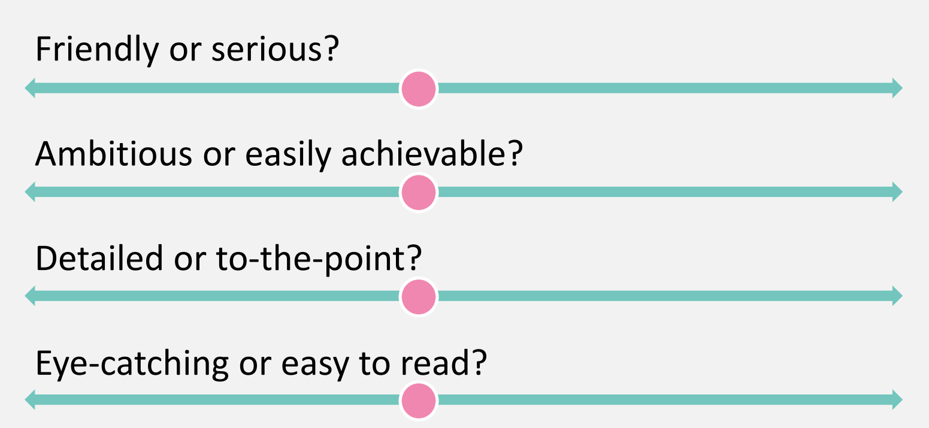
Manifesto considerations

Slide 28
Podcast
We will be creating an Election Podcast to give candidates a platform to share their ideas with students.
Recording sessions will be from Monday 15 – Thursday 18 February.
You’ll be given time to introduce yourself and talk through the key points that will appear in your manifesto.
You’ll then answer three pre-selected questions.
Staff from the Marketing and Voice departments will approve each episode before it is published to ensure fair coverage.

Slide 29
Q&A
Full-Time Officer candidates will be invited to attend a Question & Answer session via Teams Live.
This will be open to all University of Leicester students to view live.
You will be given 2 minutes to introduce yourself, outline your experience and highlight the key points from your manifesto.
This will be followed by a mix of pre-selected and live questions. The chair will aim to give all candidates a roughly equal opportunity to speak.

Slide 30
Public Speaking Workshops
If you are interested in brushing up on your delivery style, we are holding virtual Public Speaking Workshops throughout February
You can book one of the sessions at leicesterunion.com/training.
We have two running next week (Wednesday 3pm and Friday 11am)

Slide 31
What does an effective campaign look like?
Targeted
Visible and creative
Passionate
Persuasive
Clear vision or message

Slide 32
What next?
Get your nomination in by midday on Tuesday 16 February
Read through our online briefing module to make sure you're fully informed about the rules and timetable for the election.
Think about the problems relevant to the role that are faced by University of Leicester students. Can you propose any solutions?
Plan your campaign. What will you do to get your messages out and when is the best time?
Start preparing your manifesto, support team, endorsements and any campaign pages/materials. There's plenty you can get sorted before campaigning opens
Remember not to make anything public until 10am on Friday 26 February 2021!

Slide 33
Objectives
Describe the features of effective election campaign
Identify the principles of persuasive communication
Outline how social media can be used to reach a wider audience
Evaluate examples multimedia campaign materials
Explain the value of positive campaigning in elections with multiple candidates

Slide 34

Please fill out the evaluation form when you receive the follow-up email

