Slide 1



PROPOSAL ON INTERIM EXECUTIVE OFFICER STRUCTURE FOR 2024/25 ACADEMIC YEAR

Slide 2




INTRO AND RATIONALE
What:
The SU is about to undertake a full governance review with its students, staff and stakeholders supported by an external governance specialist. This proposal requests support to retain our existing officer structure for 2023/24 for the 24/25 whilst this process draws to a close.
Why:
This year (23/24) The SU has been operating with 5 officers following the resignation of the Wellbeing Officer. We believe that returning to a team of 6 would be unwise in advance of the completion of the governance review.
Summary:
This proposal is designed to ensure the SU can continue to operate at current levels whilst simultaneously providing space for us to undertake a full consultative governance review. This is a re-division of tasks.

Slide 3

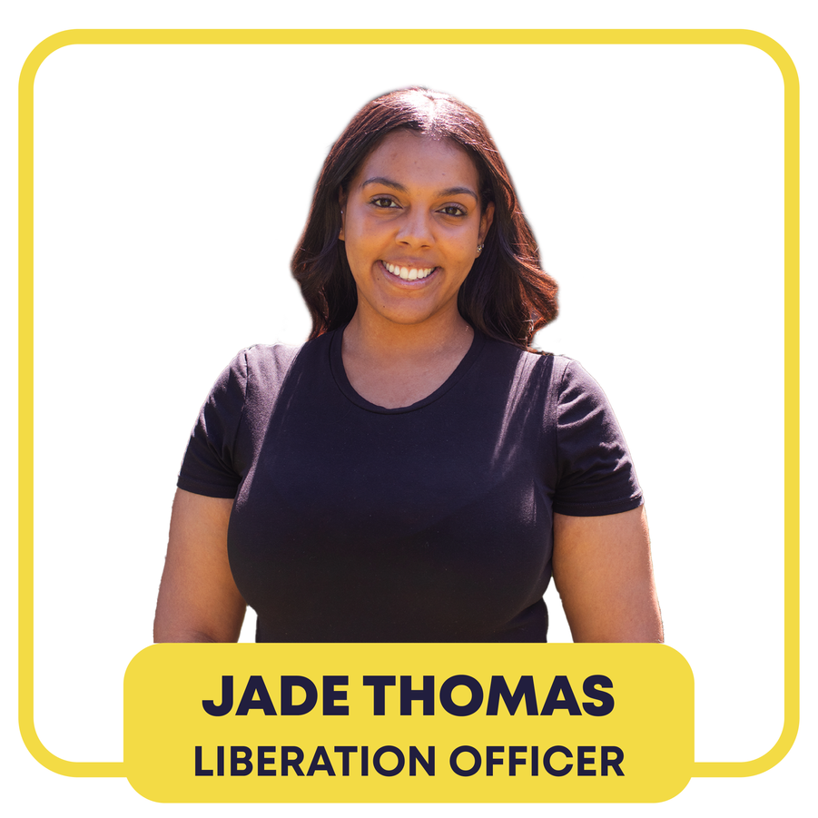



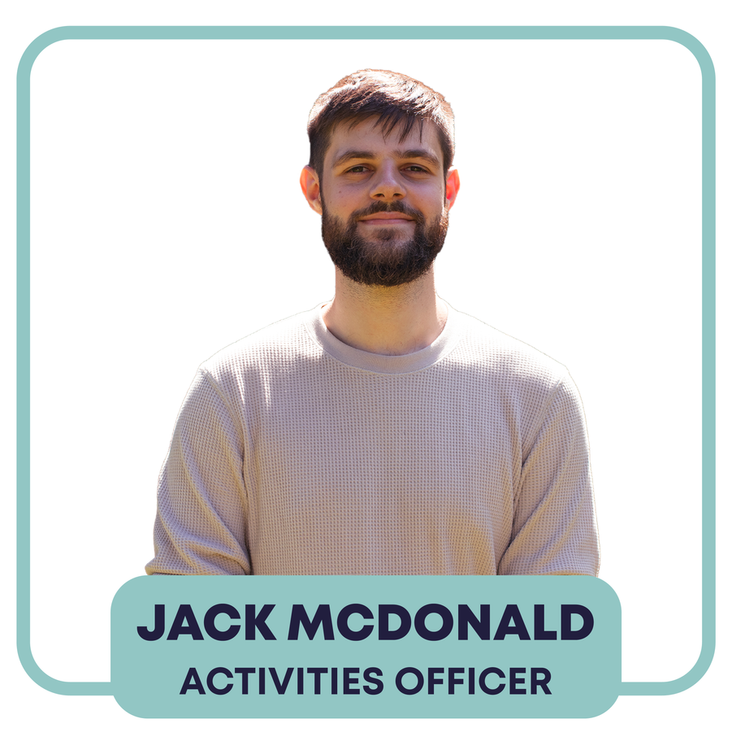

Current Officer Structure

Slide 4





What is the
Activities Officer
Societies & Student Groups
Arts & Attenborough Arts Engagement
Volunteering & the Volunteering Hub
Botanic Gardens Engagement
Fundraising + all fundraising activities
Sustainability & Sustainability Strategy
Careers & Employability
Student Recruitment

Slide 5

History of Activities Officers
2014/15 | Jamie Appleyard
2015/16 | Ayesha Hamilton
2016/17 | Dan Schofield
2017/18 | Carrie Young
2018/19 | Izzy Woolwyrch
2019/20 | Chloe Brown
2020/21 | Elle Phipps
2021/22 | Manoj Kanikanti
2022/23 | Jack McDonald
2023/24 | Jack McDonald
2008/09 | Rob Hicks
2009/10 | Phil Dixon
2010/11 | Tom Wilmot
2011/12 | Fenian o dughaen
2012/13 | Hayley Symington-Briggs
2013/14 | Maryna Danny

Slide 6


Overlap between Activities & Sports
Freshers & Welcome
Committee Training
Affiliation Documents
TL Development Tier
Awards
Committee Employability
Sports Clubs
Performance Groups
Societies Council
Movember
Activities
Officer
Sports
Officer

Slide 7



Overlap between Activities & Wellbeing
Health & Wellbeing
Eco Anxiety
Free Breakfast
Food Rescue Project &
Community Kitchen
Food Bank Project
Fundraising for Global Conflicts
Reduced Inequalities
Belonging on
Campus
Activities
Officer
Wellbeing
Officer

Slide 8




How to make this more cohesive?
Community & Wellbeing Officer:
This role is effectively a full time Sustainability Officer.
So what does that mean?
Sport & Societies Officer:
  All Student Groups & Sports Clubs
  Sports at the University
  Arts at the University
Instead of just Sports or everything except Sports, they would represent the student voice on all of them.
Sports aren’t separate from other Societies, so the divide doesn’t work too well. You can’t make big changes to one and not the other.
There is also the inclusion of Arts as they aren’t being covered effectively currently and feed into the wider remit.
Sports Officer
Health & Wellbeing | SDG 3, 6, 10, 13, 16 & 17
Fundraising | SDG 1, 2, 6, 7, 10, 11 & 16
Volunteering | SDG 1, 2, 3, 4, 6, 7, 8, 9 , 10, 12 & 17
Employability | SDG 4, 6, 8, 9, 10, 11
Sustainability | All of them! (+ SDG 5, 14 & 15)
Activities Officer
Wellbeing Officer

Slide 9


What about the 6th Officer?
More isn’t always better
  As a team, we have realised we work are more effective as a team of 5.
  More cohesive roles means better representation.
  Potential use of the £24,000 money pot.
  We have more staff support now, compared to before. (Shown to the right)
  We have been able to accommodate Wellbeing projects this year. This would be a continuation of that.
  We can elect “up to 6” Officers as per our constitution.
  Our Board of Trustees and the University have agreed in principal to this proposal.
How the SU teams have changed over the last year
Activities Team
Activities Manager
Activities Development Coordinator
Activities Coordinator
Activities Team
Activities Manager
Deputy Activities Manager
Activities Development Coordinator
Activities Development Coordinator
Volunteering Hub Coordinator
Advice Team
Deputy Advice Manager
Student Adviser
Student Adviser
Advice Team
Advice Manager
Student Adviser
Student Adviser
Support & Wellbeing Coordinator

Slide 10



Full SU Governance Review 23/24
The SU is about to begin a full governance review for 23/24 and we’d love students to put themselves forward to be involved in helping to decide what the long term future of the SU looks like.
The governance review begins from 16th January and will cover:
- Trustee Board structure and effectiveness
- Sabbatical Officer and representation structures
- A review of the articles and bylaws
This interim measure isn’t an Officer change, it’s a re-division of responsibility for 5 Officers instead of 6.
As we are undertaking such a substantial review it is felt that continuing in our current form whilst this work is undertaken will provide the best overall short and long term experience.

Slide 11

What happens if we don’t
mix the Responsibilities?
  Activities as it is, is too wide and inconsistent to be the remit of one elected officer role.
  The responsibilities of some Officer roles are not very clear to students. This will lead to campaigns and manifestos that don’t reflect the roles.
    Wellbeing Officer role holders often focus on one area, rather than the role as a whole.
    Areas like Sustainability and the Arts historically don’t get enough focus from Activities Officers.
  Sports as a remit is a little thin in comparison to the other elected officer roles.
  The Wellbeing role has fewer day-to-day responsibilities and meetings than the other roles.
  The Wellbeing role holders are seen as caseworkers, when they aren’t qualified.
    Student Health, Security & Wellbeing, should be organised by qualified permanent staff, with student consultation where relevant, not a fully representational role, elected by students.
    Wellbeing Officers can be put in a position where they conduct casework. This could be very harmful to students.
These concerns would continue for another year, when we can simply redivide responsibilities and ensure better and more effective representation.

