Slide 1





Campaigning workshop

Slide 2






Today's session includes:
  What is campaigning?
  Types of campaigns
  What is your campaign?
  Different types of campaigning
  Building your campaign team
  How to use social media effectively
  Tips and tricks
  Questions

Slide 3

Campaigning 101
Get
elected
  Achieve change by advocacy and influencing others
  Work backwards from your goal
  Consider your target audience and timeframe
  Campaigning looks different to everyone
    Use skills you are good at
    Consider context to tailor your approach
    Don’t be afraid to be creative!
Attend
election events
Campaign
(leafletting, drop-in sessions, speaking to societies)
Build your campaign:
Manifesto, social media presence, build team
Notes:
Campaigning is the act of working towards a solution to an issue by influencing others, organising actions, and mobilising others. Campaigning has historically been important in Students' Unions and in social movements. Some examples of historic campaigns that you may recognise are #MeToo, the 2019 Global Climate Strikes, and the Black Lives Matter movement.
Campaigning aims to change policy, behaviour or law, although you may be most familiar with political campaigns that aim to persuade voters. Campaigning activity can manifest in a range of different ways- from direct to indirect action- and it can include building bridges with organisations and communities.
“A person who takes part in organised activities that are intended to change something in society.”

Slide 4
Raising awareness
  Usually the first step in a campaign, not the campaign itself
  Does not achieve social change
  Consider why raising awareness is important
  What you aim to get out of raising awareness? What would the next step be?
Notes:
There is an incorrect assumption that the aim of campaigning is to raise awareness of issues, but that is not true. Raising awareness may be the start of a campaign, but solely raising awareness is not an effective tactic to creating lasting social change. Awareness may be the first step in your campaign, and can include a call to action, which would lead to further events and changes. If you would like to run an awareness campaign, think about why it is important to do these events, because that might highlight that there are more important factors to address.

Slide 5
Examples of wins from campaigning
  History has proven that campaigning works
  Campaigning is one of the most powerful approaches to achieve liberation for different groups of people and achieve societal change
  Many laws, policies, and structures in society have been shaped by change movements so that people today can reap the benefits.
Notes:
There is an incorrect assumption that the aim of campaigning is to raise awareness of issues, but that is not true. Raising awareness may be the start of a campaign, but solely raising awareness is not an effective tactic to creating lasting social change. Awareness may be the first step in your campaign, and can include a call to action, which would lead to further events and changes. If you would like to run an awareness campaign, think about why it is important to do these events, because that might highlight that there are more important factors to address.

Slide 6
Examples of wins from campaigning
Nationally At UOL
  Sick leave
  Child labour laws
  Same-sex marriage
  Anti-discrimination laws
  Access to contraception
  The five-day working week
  The right for women to vote
  The National Minimum Wage
  Paid holidays and annual leave
  Legal protection of characteristics.
  Creation of mature students' space
  Introduction of pronoun badges in the SU
  Transgender healthcare resource pack created for students
  Creation of a child-friendly room exclusively for students with children
  Introduction of Liberation Room for student groups
  Consent awareness including posters across the SU.

Slide 7


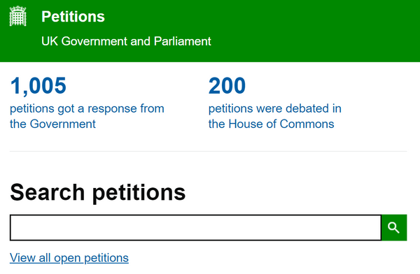
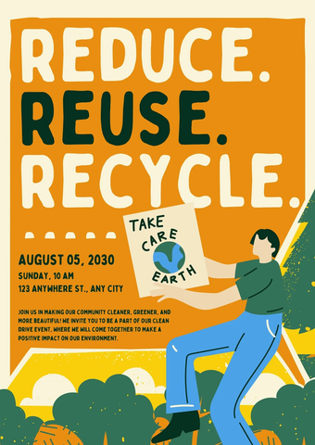




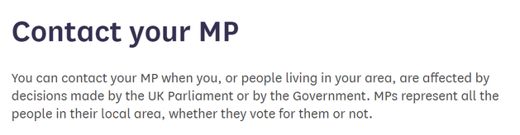
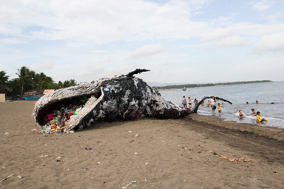
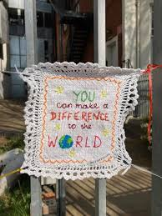
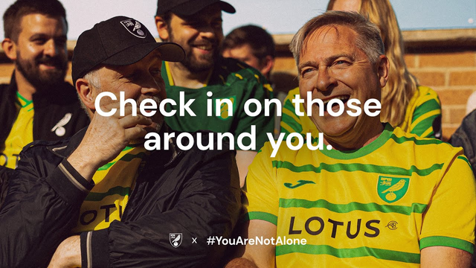
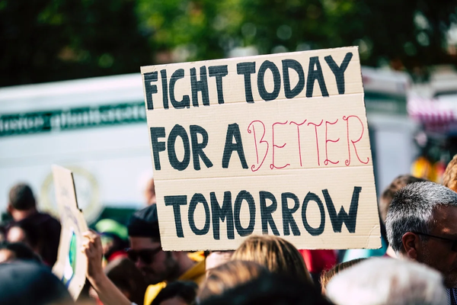
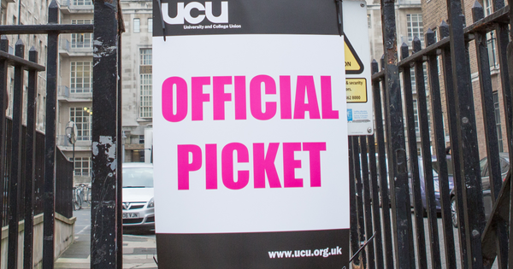
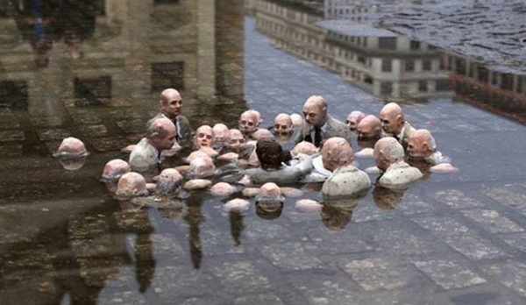

Research, data and storytelling
Newspapers/ journals
Digital campaigning e.g. calls to action
Political campaigns /manifestos
Posters/ information/ awareness campaigns
Digital campaigning e.g. videos/ ads
Direct action e.g. protest, strike, rally, boycott, sit in
Facilitation workshops
Artivism/ craftivism / installations

Slide 8

Individual and collective change
Changes in individual’s confidence, knowledge, skills and committment
An individual’s access to resources for organising e.g. money, support
Informal
Formal
Changes in ideas, beliefs, social norms, behaviour and socialisation at large
Change at legal, policy, or institutional level (local or global scale) e.g. government, business
Systemic change

Slide 9
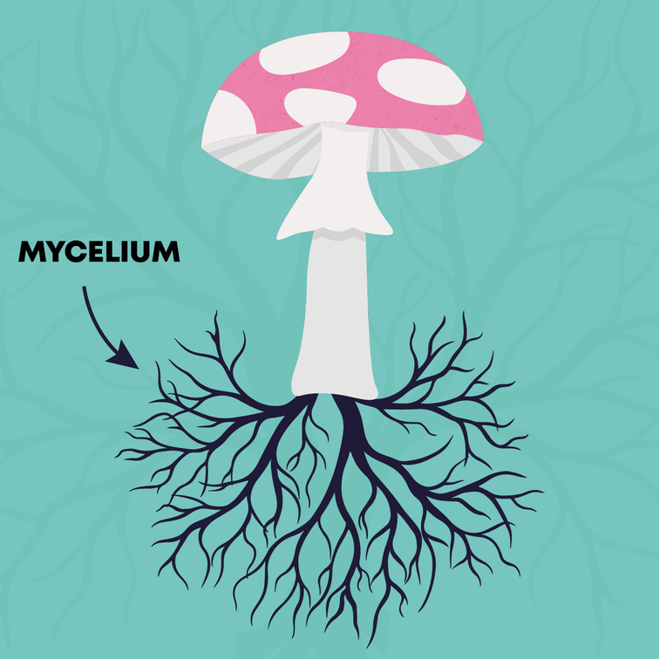
Campaign “groundwork”
  Systemic change does not happen overnight
  Hyphae = an action/ person who organises
    branching filaments extending into soil
    gather nutrients
  Make mushroom appear = campaign goal
  From above: only see mushroom, not network below
  Many activists build on the work of previous people
  Philosophy: the mushroom will appear eventually.
Taken from Mikaela Loach, climate justice activist

Slide 10
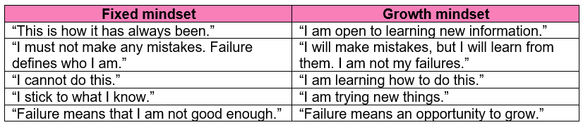
But what can I do?
Anyone can make a difference.
Mindset is everything.

Slide 11
What is your campaign?
(It is not only to get elected!)
Think about the specific problems at the university:
    Is this a problem many people are passionate about?
    What is the scale of this problem?
    Are there deeper issues that cause the problem?
    What evidence do you have?
    Who do these problems affect?
    What could you realistically tackle as an elected officer?
    What solutions do you have in mind?
    What impact would your solutions have?

Slide 12
Find your “why”
  Campaigns are built on the sense of injustice and that something needs to change.
  Relate to your own experiences and find commonality with:
    Peers and your wider network
    People on your course / in your year
    People in your school / department
    Your community.
Think global, act local.

Slide 13

What are your goals?
A goal without a plan is just a wish
Think SMART:
Specific- Who? What? Why? How?
Measurable- Give relevant metrics you can compare progress with
Achievable- Be realistic about your sphere of influence and resources
Relevant- Why this problem? How does this link to other issues?
Time- When do you want to achieve this by? What is the timeline?

Slide 14
What does success look like?
Raising awareness is not enough to achieve social change.
You need a theory of change and call to action:
“Donate to this charity to enable...” “Get vaccinated to stop...”
  100 signatures on a petition/ passing a policy?
  Raising £500?
  Engaging 200 students?
  Changing student behaviour?
  Student satisfaction?
  Increasing student utilisation of support services?

Slide 15
Working backwards example
  Example manifesto aim:
“I want to build a safe, thriving community for LGBTQIA + students”
  What does that look like?
Events, open discussions, social media posts, creating a forum
  What events and how often?
Run freshers stall, social events, collaborations with other officers, open conversation events. At least one event a month
  How will you communicate with students?
Statements on PTO Instagram, promoting events in SU newsletters and on the website, create a mailing list.

Slide 16
Working backwards continued
  Who will I work with?
Activities Team, Voice Team, Executive and Part-Time officers, Estates, ResLife, EDI team
  What will I need?
Room bookings, marketing assets, copy for newsletters, items for events, risk assessments, other equipment
  When should I start planning?
At least one month before smaller events and campaigns
At least two months before larger events and campaigns so there is time for everything to be booked, bought and reserved.

Slide 17
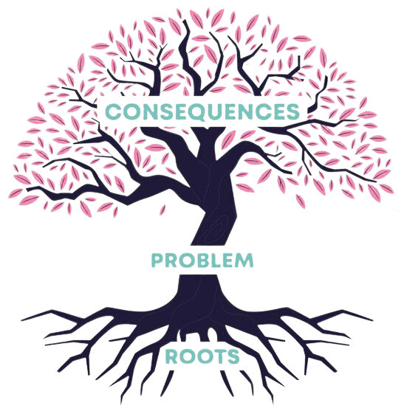
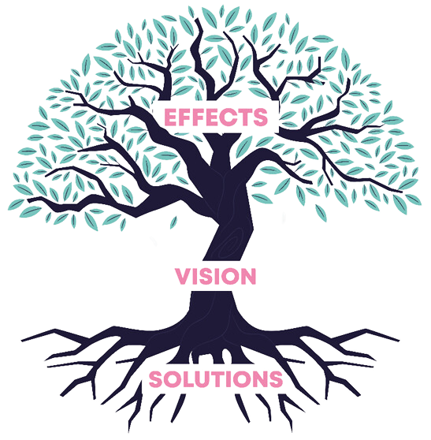
Become solutions-orientated by focusing on your vision

Slide 18
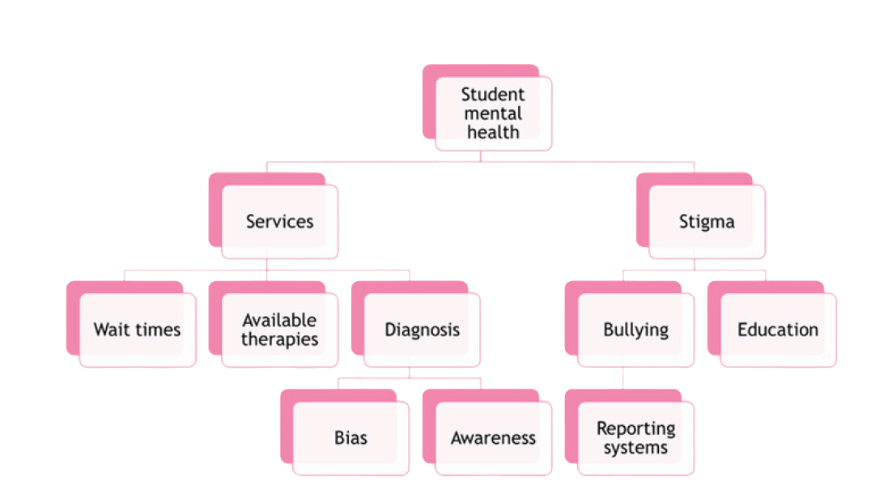
Addressing the root issues

Slide 19

Addressing the root issues

Slide 20
An example
Stage 1
  Destigmatising diagnosis campaign
  Promote support services and student rights
Stage 2
  Improve reporting systems for bullying/ harassment
  Education on wellbeing/ disability services for Personal Tutors
Stage 3
  Increase number of counsellors on campus (£££)
  Improve quality of counselling services.

Slide 21
Power mapping
  One directional
  Limited impact and action to be made
You
The VC

Slide 22
Relational power mapping
An example
Student
Council
Media
groups/
The press
Target:
The VC
Student
groups
The SU
You
The Uni

Slide 23

How involved they are
The GIDA matrix
Influencer
Decision-maker
Exec Officers
Academic Reps
MPs/Councillors
University Council
Trustee Board
  Who can work with you on your campaign?
  Who is preventing you from achieving your goals?
Level of power
Gatekeeper
Authoriser
Secretaries
Security
Councils
Leicester 100

Slide 24
Structure of the Students’ Union
Trustee board
Can overrule decisions made at Leicester 100
Leicester 100
Vote on policy and can call a referenda
Councils:
Academic, Liberation, Sports, Societies
Formulate policy and decision-making within their area to guide the work of the SU
Bring forward ideas for the SU to consider within the relevant councils/ take to Leicester 100. Need 100 likes to bring idea yourself to L100
Ideas System

Slide 25

Leicester 100
  Leicester 100 is the dynamic group responsible for voting on and approving Union policy.
  It is a panel of ~100 students who represent a demographically balanced cross-section of our vibrant student community.
  Ensures a diverse range of engaged perspectives on various issues and policy ideas, truly reflecting and representing the voice of our student body.
  Highest level of decision-making students can get involved with.

Slide 26
Different types of campaigning
  A mix of online and in person is highly effective
  Which approaches are more effective?
Collecting feedback from students about your issue
Giving speeches at society events
Leafletting and chatting to passing students
Putting up posters and banners around campus
Chatting to students within buildings
Tiktoks and memes
Announcing your candidacy at the end of your lectures
Going to Rockstar nights with campaigning attire
Promoting key manifesto aims on social media

Slide 27



Scale of agreement
This is the ‘Goldilocks zone’ where you are most persuasive. People within this range are more receptive to open conversations and are easily convinced. You want to target their concerns to convince them of the validity of your campaign, and push them to support your work.
0%
25%
50%
75%
100%
These people are unlikely to listen to your perspective, regardless of what approach you use, so it is a waste of time to focus on this demographic.
These people are already on your side! You don’t need to convince them to agree with your cause, although you may want to encourage them to support your work by joining events or sharing your work.

Slide 28


Building your campaigning team
  Lone wolf vs organising (building a team to achieve a common goal)
  Create a form and do a skills audit
    What motivates people?
    What are they good at?
    How much can they commit?
  Collect contact details and create a group chat
  Delegate roles and split within a timetable
  Set up regular team check-in meetings
Note: Only students at the University can be part of your campaign team.
Notes:
So, you've decided on what approach you'd like to take. Now it's time to consider how you can make this acheivable. You might want to do this all alone, if so, kudos, but it will be very time consuming and could lead to burnout.
To avoid that, I suggest that each of you build a campaign team of people who will support you and help you get elected. It could be friends, coursemates or people from your society. These will help you get your message across effectively and it means that you have a support network to prevent burnout.
Before you reach out to people, have a think about what kind of skills you need for your campaign. It could be copywriting, graphic making, public speaking, organisation, persuasion etc.
My best tip would be to create a form where people tell you what their skills are. You want people to find the campaign meaningful and give them a purpose. Find out what people are good at, what motivates them and how much they can commit. With that data you can collectively appoint roles and form your team to suit what resources you need.

Slide 29

How to use social media effectively
  Decide what you will use social media for:
    Recruiting a campaign team?
    Introducing your candidacy and campaign?
    Raising awareness of issues and your solutions?
  Ideas for your campaign accounts:
    Background information
    What you stand for
    Key manifesto pledges
    Highlight previous wins
    Why people should vote for you.

Slide 30
How to use social media effectively
  Testimonies and endorsements
  Repetition using different angles
  Branding and themes
  Slogan or hashtag (or memes?)
  Give information about where to vote
  Share a link to your manifesto
  Be creative, respectful to others and positive
  It’s ok to get friends to help you with designing things
  Accessibility: add captions, alt text and keep easy to read
  Don’t include the University or Students’ Union logo!

Slide 31
Tips and tricks
  Prioritise rest to prevent burnout
  Wellbeing space during working hours
  Meet with staff buddy if you need to talk to someone
  Use the right platform for the campaign e.g. Instagram/Tiktok for visual content, X/Blue Sky for text-based approaches
  Use your budget effectively (and don’t go over it!)
  If you’re unsure of anything please email su-elections@leicester.ac.uk
  It is okay to look at past manifestos to get ideas, but avoid plagiarising or copying directly.
  You can use trial versions of Canva to help, or buy premium as part of your budget
  We have created at template as a starting point:
(https://www.leicesterunion.com/voice/democracy/elections/electionresources/)

Slide 32
Any questions?

